Slide 1
Chapter 6 Strings

Slide 2
Objectives
To learn how to create strings .
To encode characters using ASCII and Unicode .
To use the ord to obtain a numerical code for a character and chr to convert a numerical code to a character .
To represent special characters using the escape sequence.
To use the len function to obtain the length of a string.
To access string elements by using the index operator ([]).
To get a substring from a larger string by using the slicing str[start:end] operator.
To concatenate strings by using the + operator and to duplicate strings by using the * operator.
To use the in and not in operators to determine whether a string is contained within another string.
To compare strings by using comparison operators (==, !=, <, <=, >, and >=).
To iterate characters in a string by using a for loop.
To learn about string functions and methods.
To introduce simple cryptographic algorithms.

Slide 3
Strings and Characters
Strings are fundamental in computer science, and processing strings is a common task in programming.
In Python, all data—including numbers and strings—are actually objects..
A string is a sequence of characters. String literals can be enclosed in matching single quotes (') or double quotes ("). Python does not have a data type for characters. A single-character string represents a character.

Slide 4
Strings (cont’d.)
When you want to have a string that contains a single quote, you use double quotes around the outside of the string.
When you want to have double quotes inside your string, you use single quotes around the outside.

Slide 5
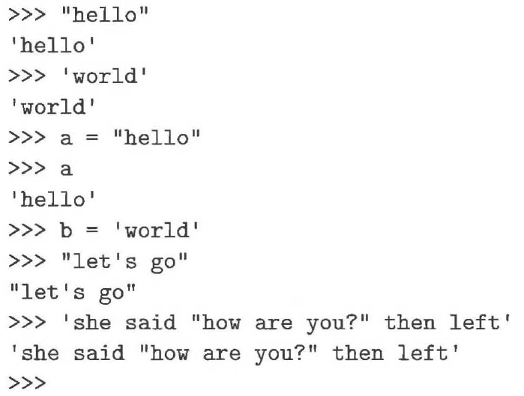
Strings (cont’d.)

Slide 6
And then there is “”” “””
Triple quotes preserve both the vertical and horizontal formatting of the string
Allows you to type tables, paragraphs, whatever and preserve the formatting
"""this is
a test
today"""

Slide 7
Non-Printing Characters (Escape Sequences)
Description Escape Sequence Unicode
Tab \t \u0009
Linefeed \n \u000A
Backslash \\ \u005C
Single Quote \' \u0027
Double Quote \" \u0022

Slide 8
Unicode and ASCII Code
Python characters use Unicode, a 16-bit encoding scheme Python supports Unicode. Unicode is an encoding scheme for representing international characters. ASCII is a small subset of Unicode.

Slide 9
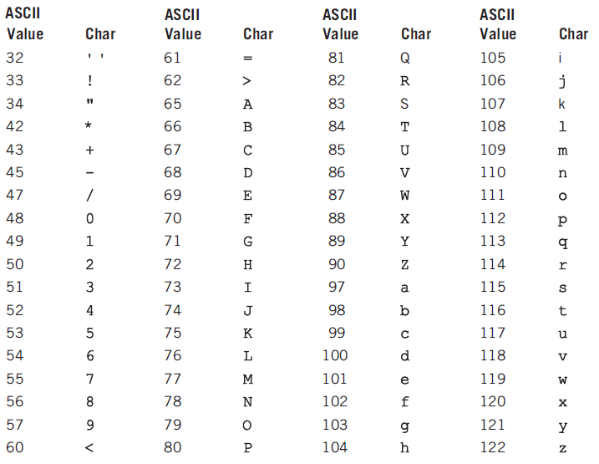
The ASCII Character Set

Slide 10
ASCII Character Set, cont.
ASCII Character Set is a subset of the Unicode from \u0000 to \u007f

Slide 11
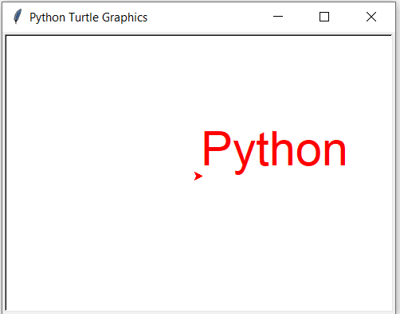
ASCII Character Set
import turtle
turtle.color("red")
turtle.write('\u0050\u0079\u0074\u0068\u006F\u006E', font = ('Arial', 36, 'normal'))
turtle.done()

Slide 12
Character Functions
Python contains some built-in functions for converting a character to a number and vice versa.
The ord function converts a character to a number
The chr function converts a number to a character.
>>> ch = 'a'
>>> ord(ch)
>>> 97
>>> chr(98)
>>> 'b'

Slide 13
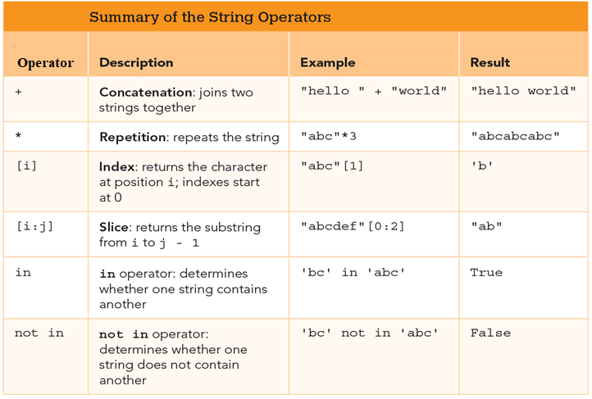
Strings Operators

Slide 14
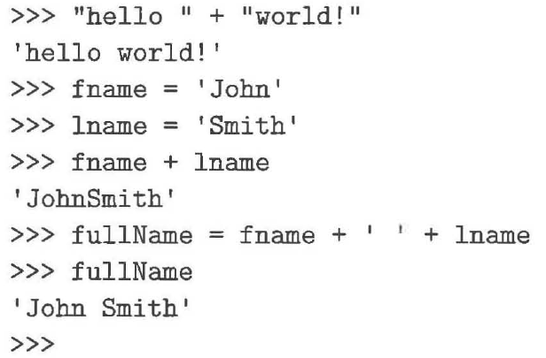
Concatenation Operator (+)
When + is applied to two strings, we call it the concatenation operator.

Slide 15
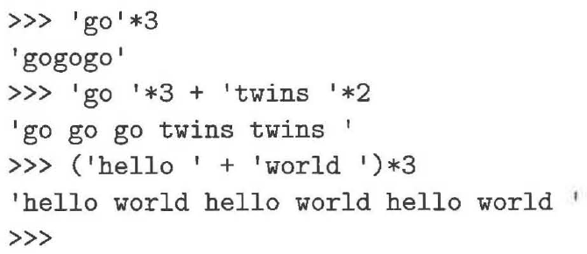
Repetition Operator (*)
Takes a string and repeats it as many times as you would like.
Repetition operator has a higher precedence than concatenation.

Slide 16
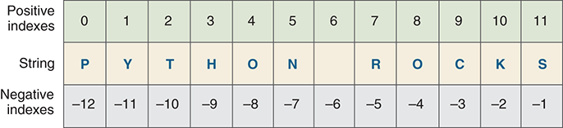
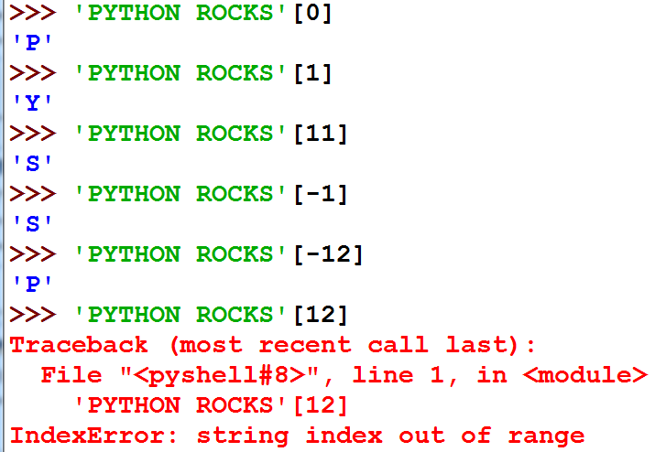
Indexing Operator ([ ])
Gets a particular characters in a string.

Slide 17
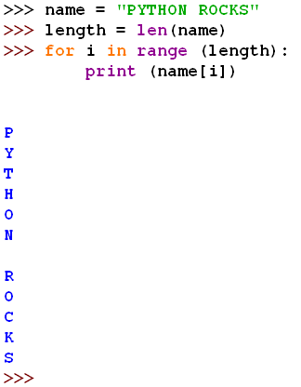
Indexing Operator ([ ]) (cont’d.)
We can go one step further and combine the range function with the len function to allow us to access each character in a string.

Slide 18
For Loops
s = “PYTHON”
for i in range(0, len(s), 2): print(s[i])
for ch in s: print(ch)

Slide 19
Slicing Operator ([:])
Similar to the index operator except that it can get multicharacter parts of the string.
We often call these parts of a string substrings.
The first number after the left square bracket gives the starting index of the first character in the substring.
The number after the ':' is the index that is one after the last character selected for the substring.
This is similar to the bounds of the range function where the upper bound is not included.

Slide 20
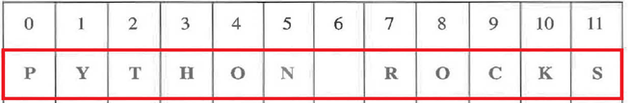
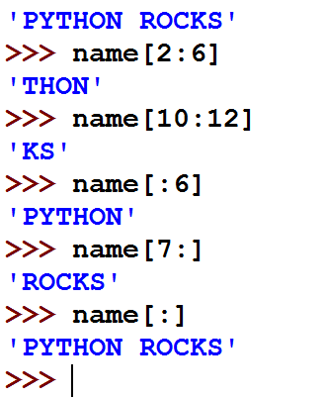
Slicing Operator ([:]) (cont’d.)

Slide 21
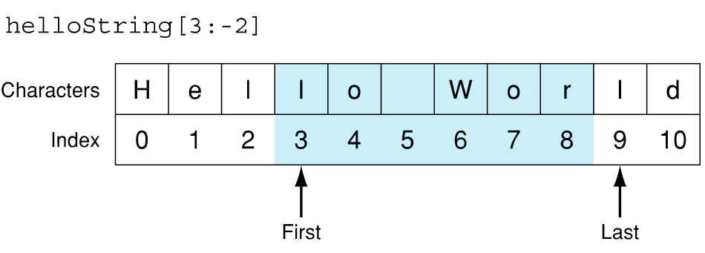
Slicing Operator ([:]) (cont’d.)

Slide 22
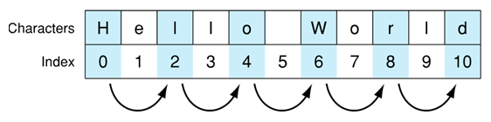
Extended Slicing
Takes three arguments:
[start:finish:countBy]
defaults are:
start is beginning, finish is end, countBy is 1
To get every other letter
my_str = 'hello world'
my_str[0:11:2] ⇒ 'hlowrd'

Slide 23
Some Python Idioms
idioms are python “phrases” that are used for a common task that might be less obvious to non-python folk
how to make a copy of a string:
my_str = 'hi mom'
new_str = my_str[:]
how to reverse a string
my_str = "madam I'm adam"
reverseStr = my_str[::-1]

Slide 24
Strings are Immutable
strings are immutable, that is you cannot change one once you make it:
a_str = 'spam'
a_str[1] = 'l' → ERROR
However, you can use it to make another string (copy it, slice it, etc.)
new_str= a_str[:1] + 'l' + a_str[2:]
a_str → 'spam'
new_str →'slam'

Slide 25
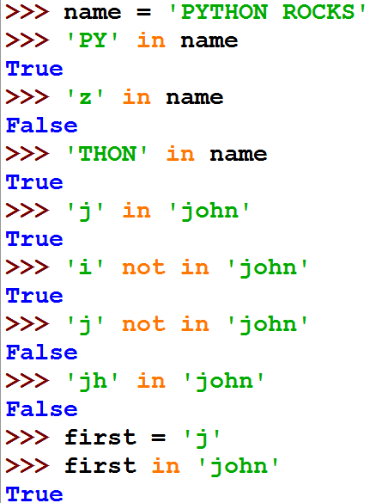
Membership Operators ‘in’ and ‘not in’
The in operator determines whether one string contains another.
The not in operator determines whether one string does not contain another.

Slide 26
Comparing Strings
>>> s1 = "green"
>>> s2 = "glow"
>>> s1 == s2
False
>>> s1 != s2
True
>>> s1 > s2
True
>>> s1 >= s2
True
>>> s1 < s2
False
>>> s1 <= s2
False

Slide 27
Problem: Checking Palindrome
A string is a palindrome if it reads the same forward and backward. The words “mom,” “dad,” and “noon,” for instance, are all palindromes.
The problem is to write a program that prompts the user to enter a string and reports whether the string is a palindrome. One solution is to check whether the first character in the string is the same as the last character. If so, check whether the second character is the same as the second-to-last character. This process continues until a mismatch is found or all the characters in the string are checked, except for the middle character if the string has an odd number of characters.

Slide 28
# Prompt the user to enter a string
s = input("Enter a string: ")
# The index of the first character in the string
low = 0
# The index of the last character in the string
high = len(s) - 1
isPalindrome = True
while low < high:
if s[low] != s[high]:
isPalindrome = False # Not a palindrome
break
low += 1
high -= 1
if isPalindrome:
print(s, "is a palindrome")
else:
print(s, "is not a palindrome")
Enter a string: noon
noon is a palindrome
Enter a string: moon
moon is not a palindrome

Slide 29
String Functions and Methods
A function is a program that performs some operation.
A function takes some number of inputs (arguments) and returns a value based on the arguments and the function's operation.
a method is a variation on a function
like a function, it represents a program
like a function, it has input arguments and an output
Unlike a function, it is applied in the context of a particular object.
This is indicated by the dot notation invocation

Slide 30
String Function: str
The str function can be used to convert a number into a string. For example,
>>> s = str(3.4) # Convert a float to string
>>> s
'3.4'
>>> s = str(3) # Convert an integer to string
>>> s
'3'
>>>

Slide 31
String Function: len
The len function takes as an argument a string and returns an integer, the length of a string.
my_str = 'Hello World'
len(my_str) ⇒ 11 # space counts!

Slide 32
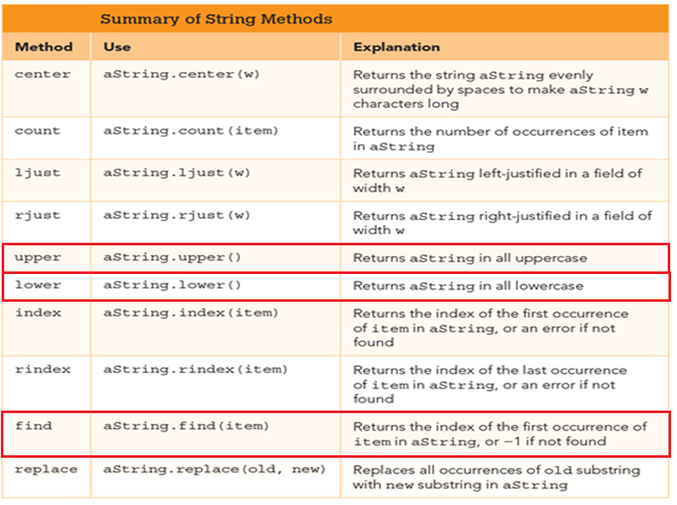
String Methods

Slide 33
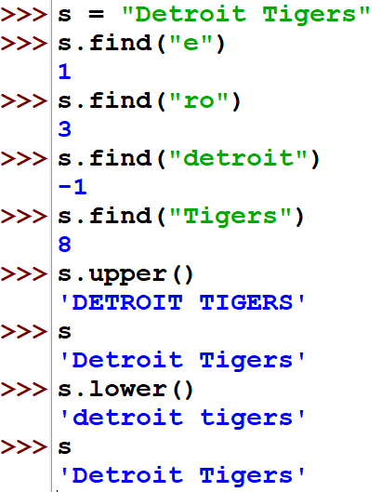

Slide 34
Chaining Methods
Methods can be chained together.
Perform first operation, yielding an object
Use the yielded object for the next method
my_str = 'Python Rules!'
my_str.upper() ⇒ 'PYTHON RULES!'
my_str.upper().find('O')
⇒ 4

Slide 35
Nesting Methods
The result of one method becomes an argument to another.
Do the inner parenthetical expression first, thenuse the result as an argument of the outer method.
s = "APPLE"
print(s.lower())
‘apple’

Slide 36
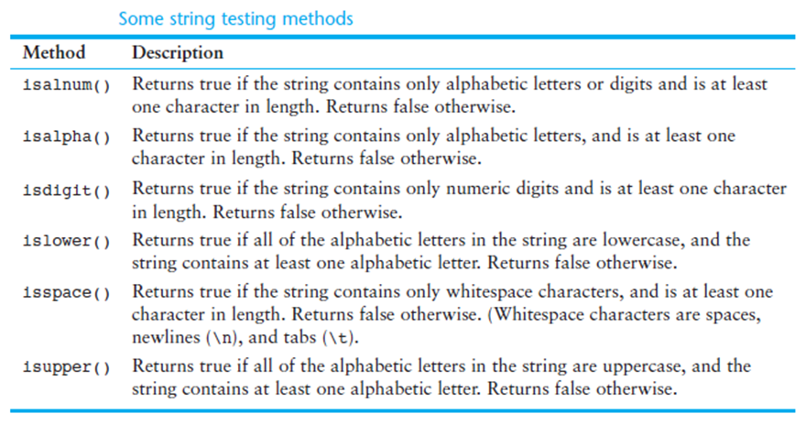
Other Useful Methods

Slide 37
Cryptography
Cryptography is the science of writing secret code.
When you make a purchase on the Web or check your grades or bank online, you are using cryptography.
Modern cryptography exists at the intersection of the disciplines of mathematics, computer science, electrical engineering, communication science, and physics.
Applications of cryptography include electronic commerce, chip-based payment cards, digital currencies, computer passwords, and military communications.

Slide 38
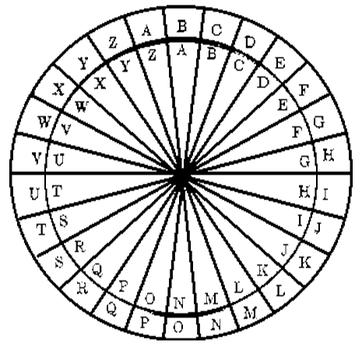
Cryptography (cont’d.)
PYTHON
OXSGNM
Alphabet shift ciphers are believed to have been used by Julius Caesar over 2,000 years ago. This is an example with k = 1. In other words, the letters in the alphabet are shifted three in one direction to encrypt and three in the other direction to decrypt.
https://en.wikipedia.org/wiki/Cryptography

Slide 39
Encoding and Decoding Messages
Cryptography is the science of making messages secure.
Transforming readable messages into unreadable messages and back again.
Messages that are readable are called plaintext.
Messages that are unreadable are called ciphertext.
The process of turning plaintext into ciphertex is called encryption.
The reverse process of turning ciphertext into plaintext is called decryption.

Slide 40

Encoding and Decoding Messages (cont’d.)

Slide 41

Encrypting Messages
Write a Python function that takes the plaintext message as a parameter and returns the ciphertext message.

Slide 42
Encrypting Messages (cont’d.)
One of the easiest ways to encrypt a message is to simply scramble the letters.
For example the word "apple" could be randomly transformed to "lapep."
There are 120 different possible arrangements of the word "apple."
Encryption and decryption algorithms must work together in some agreed upon way, with the encryption algorithm scrambling letters and the decryption algorithm unscrambling them.

Slide 43
Encrypting Messages (cont’d.)
One way to scramble the letters of a message is to separate the message into two groups of characters.
The first group composed of the even-numbered characters and the second group of the odd-numbered characters.
If we create one string out of the even-numbered characters and another out of the odd, we can concatenate the two new strings together to form the ciphertext string.
Because this results in a string with the characters shuffled to new positions, we call this a transposition cipher(rail fence cipher).

Slide 44
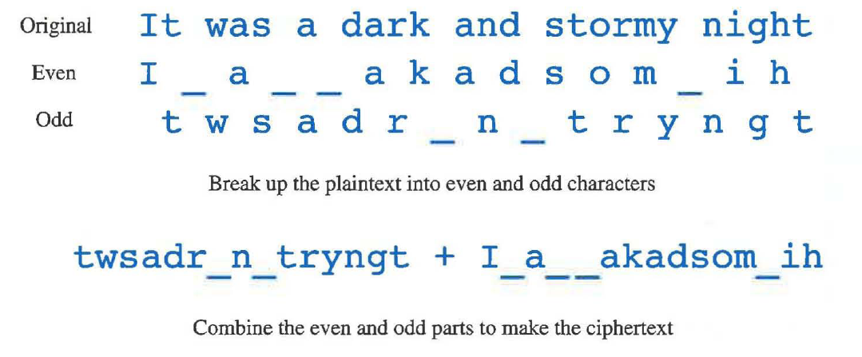
Transposition Cipher

Slide 45
Encrypting Using Transposition
def scramble2Encrypt(plainText):
evenChars = ""
oddChars = ""
charCount = 0
for ch in plainText:
if charCount % 2 == 0:
evenChars = evenChars + ch
else:
oddChars = oddChars + ch
charCount = charCount + 1
cipherText = oddChars + evenChars
return cipherText
print(scramble2Encrypt("abababab"))
print(scramble2Encrypt("ababababc"))
print(scramble2Encrypt("It was a dark and stormy night"))
print(scramble2Encrypt("a"))
print(scramble2Encrypt(""))
bbbbaaaa
bbbbaaaac
twsadr n tryngtI a akadsom ih
a

Slide 46
Encrypting Using Transposition (cont’d.)
The scramble2Encrypt function makes use of the accumulator pattern in several different places.
The order of variables in the concatenation is not accidental.
Notice that some of the test cases are just nonsense strings, but they are chosen carefully to make it easy to see if the function is working the way we think it should.
Notice that we test some boundary cases like a string of length 1 and even an empty string.

Slide 47
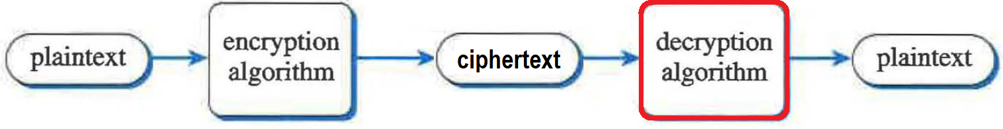
Decrypting Messages
Write a function to decrypt a message that was encrypted by scramble2Encrypt function.

Slide 48
Decrypting a Transposed Message
To restore the plaintext string, we start out by splitting the ciphertext in half.
The first half of the string contains the odd characters from our original message, and the second half of the string contains the even characters.

Slide 49
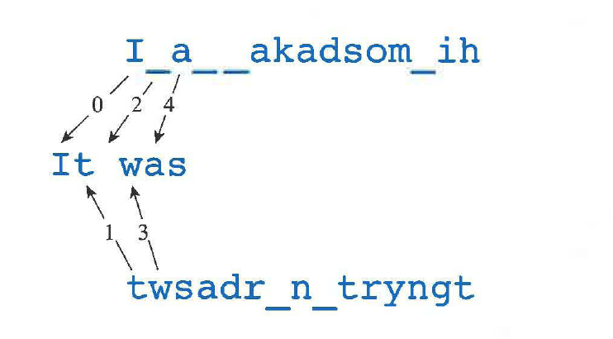
Decrypting a Transposed Message (cont’d.)

Slide 50
Decrypting a Transposed Message (cont’d.)
One detail to consider when reconstructing the plaintext message is that we may have one more character in the even character string than we do in the odd character string.
We can easily check for this by comparing the lengths of the two strings.
If the odd-numbered character string is shorter than the even, we simply concatenate the last character from the even string onto the plaintext.

Slide 51
Decrypting a Transposed Message (cont’d.)
def scramble2Decrypt(cipherText):
halfLength = len(cipherText) // 2
oddChars = cipherText[:halfLength]
evenChars = cipherText[halfLength:]
plainText = ""
for i in range(halfLength):
plainText = plainText + evenChars[i]
plainText = plainText + oddChars[i]
if len(oddChars) < len(evenChars):
plainText = plainText + evenChars[-1]
return plainText
print (scramble2Decrypt("twsadr n tryngtI a akadsom ih"))
It was a dark and stormy night

Slide 52
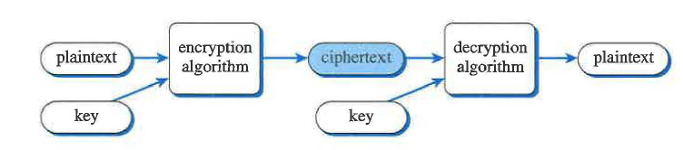
Substitution Cipher
The substitution cipher substitutes one letter for another throughout a message.
The substitution cipher has one big advantage over the transposition cipher: It uses a key.
The key is created by rearranging the alphabet.
If we just consider the 26 letters of the alphabet, there are 26 factorial different possible rearrangements of the alphabet.

Slide 53
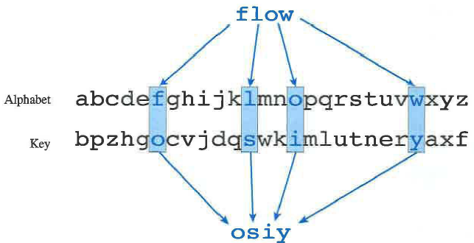
Substitution Cipher (cont’d.)
The important step in the encryption process is to take a letter from the plaintext alphabet and map it into a letter in the ciphertext alphabet.

Slide 54
Substitution Cipher (cont’d.)
def substitutionEncrypt(plainText,key):
alphabet = "abcdefghijklmnopqrstuvwxyz "
plainText = plainText.lower()
cipherText = ""
for ch in plainText:
idx = alphabet.find(ch)
cipherText = cipherText + key[idx]
return cipherText
testKey1 = "zyxwvutsrqponmlkjihgfedcba "
testKey2 = "ouwckbjmpzyexavrltsfgdqihn "
cipherText = substitutionEncrypt("To BE Or Not TO Be",testKey1)
print(cipherText)
cipherText = substitutionEncrypt("To BE Or Not TO Be",testKey2)
print(cipherText)
gl yv li mlg gl yv
fv uk vt avf fv uk

Slide 55
Creating a Key
The strength of the substitution cipher lies in the ability of two people to share a key.
That key must represent a scrambled version of the 26 letters of the alphabet.
The main idea in this algorithm is that we want to randomly select one letter from the alphabet to include in our key, and then to randomly select another letter and another until we have selected all 26 letters in a random order.

Slide 56
Creating a Key (cont’d.)
import random
def keyGen():
alphabet = "abcdefghijklmnopqrstuvwxyz"
key = ""
for i in range(len(alphabet)):
idx = random.randint(0,len(alphabet)-1)
key = key + alphabet[idx]
alphabet = alphabet[:idx] + alphabet[idx+1:]
return key
print(keyGen())
print(keyGen())
print(keyGen())
vshudqyegxitbofcnjmplwrazk
durqxbhnesvlokiwzjfatycgpm
haqwpsumlexbdigoytfrjvnczk

